Slide 1
Perkins Middle School
Athletics
2020-2021

Slide 2
Rank ONE Sports + Health Login
https://www.rankonesport.com/content/Home/MemberLogin
Enter this in your Web Browser.

Slide 3
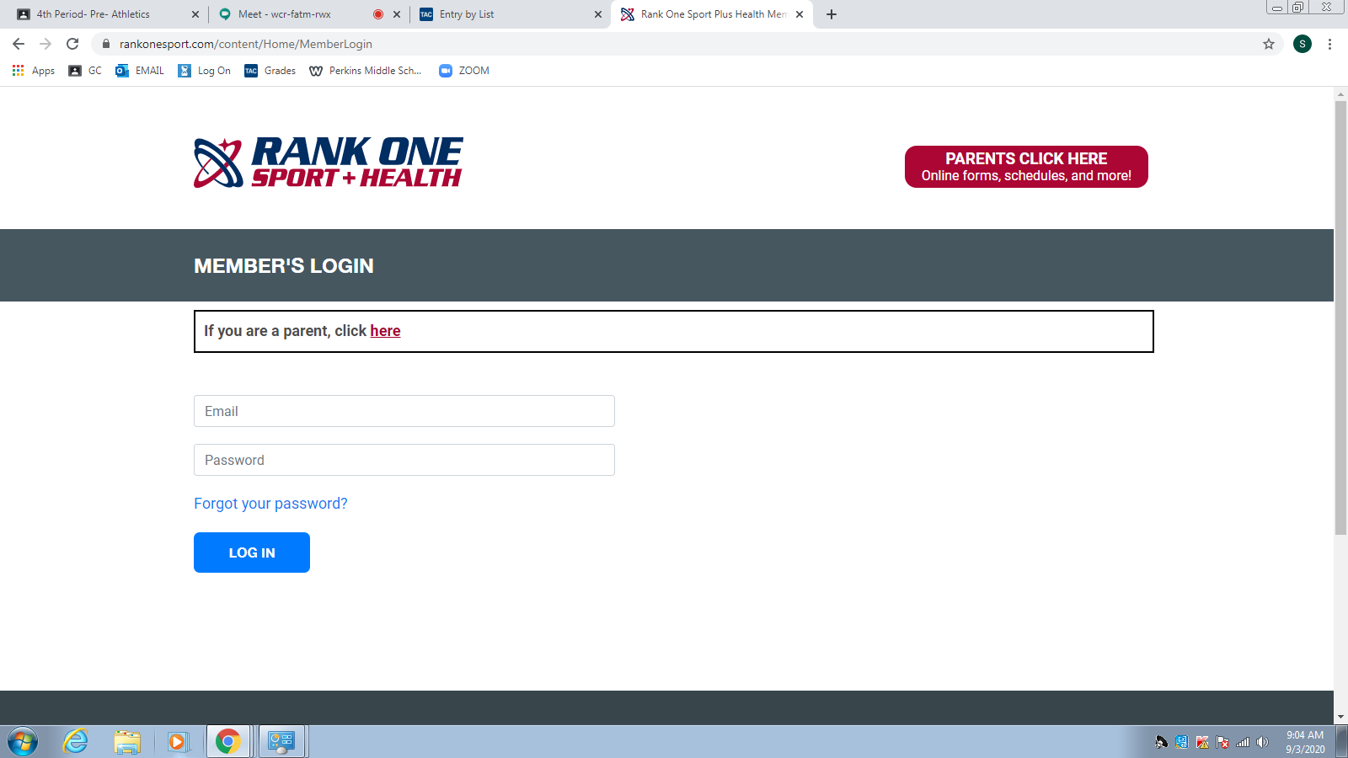
Rank ONE Sports + Health Login
https://www.rankonesport.com/content/Home/MemberLogin
Parents Click HERE

Slide 4
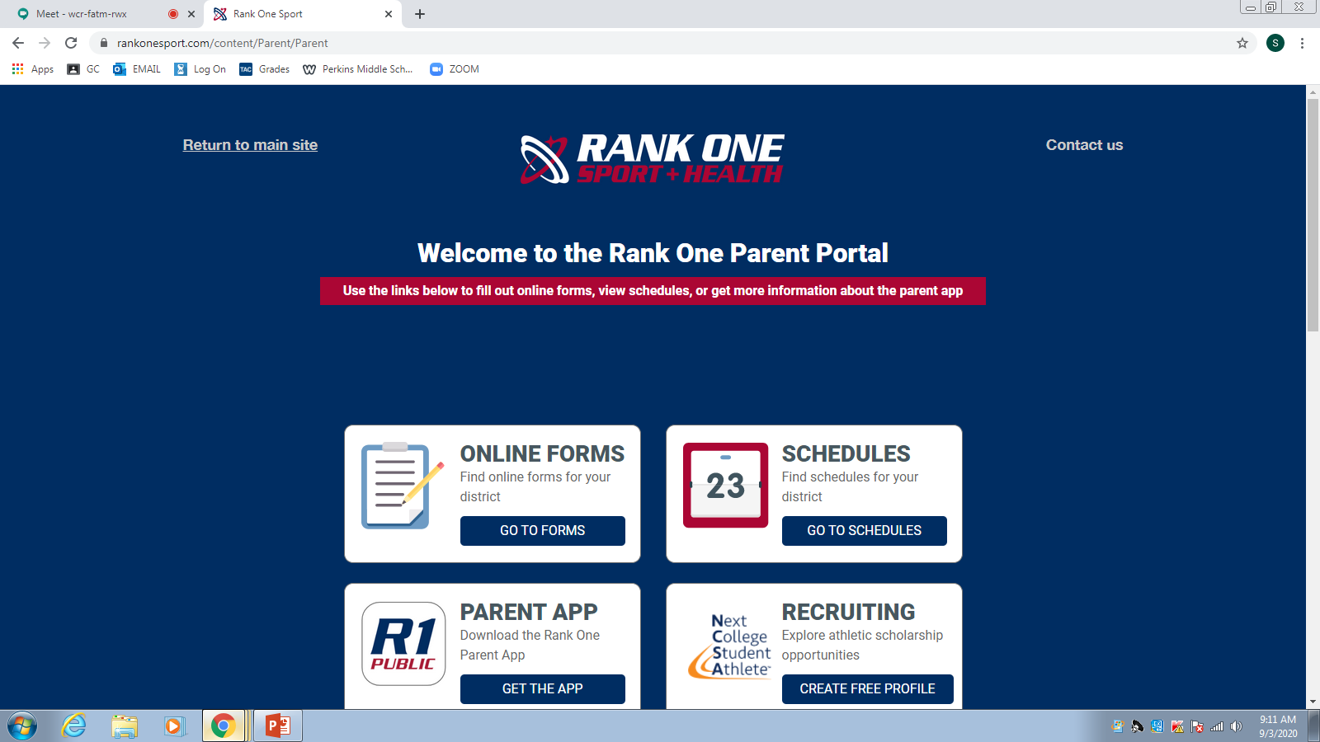
2nd Step
Click – On Online Forms

Slide 5
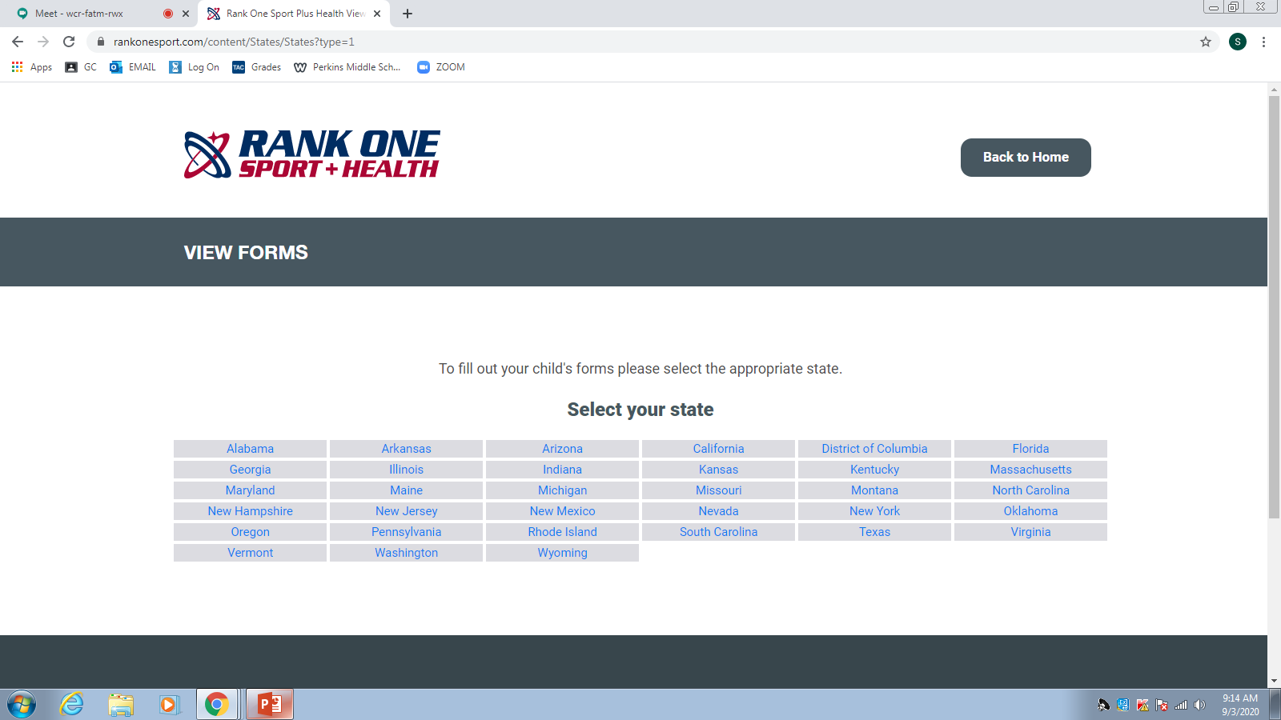
3rd Step
Click – On Online Forms
Click - Texas

Slide 6
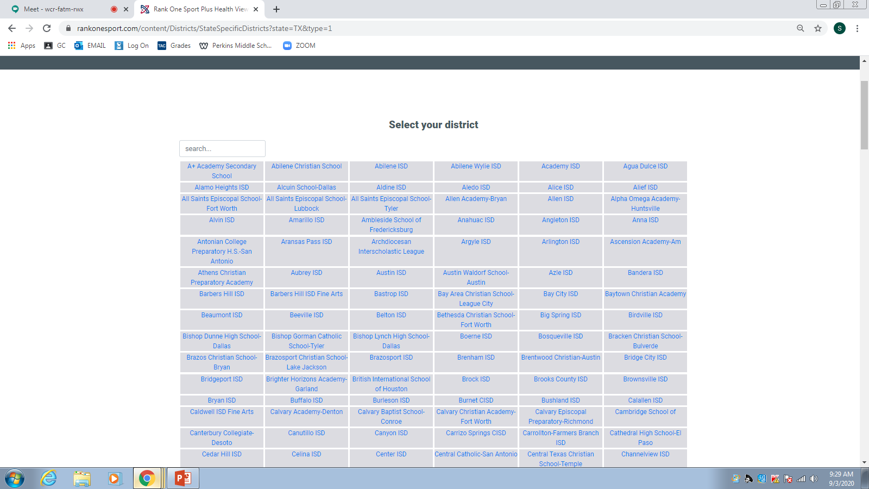
4th Step
Click – On Online Forms
Click- Brownsville ISD

Slide 7
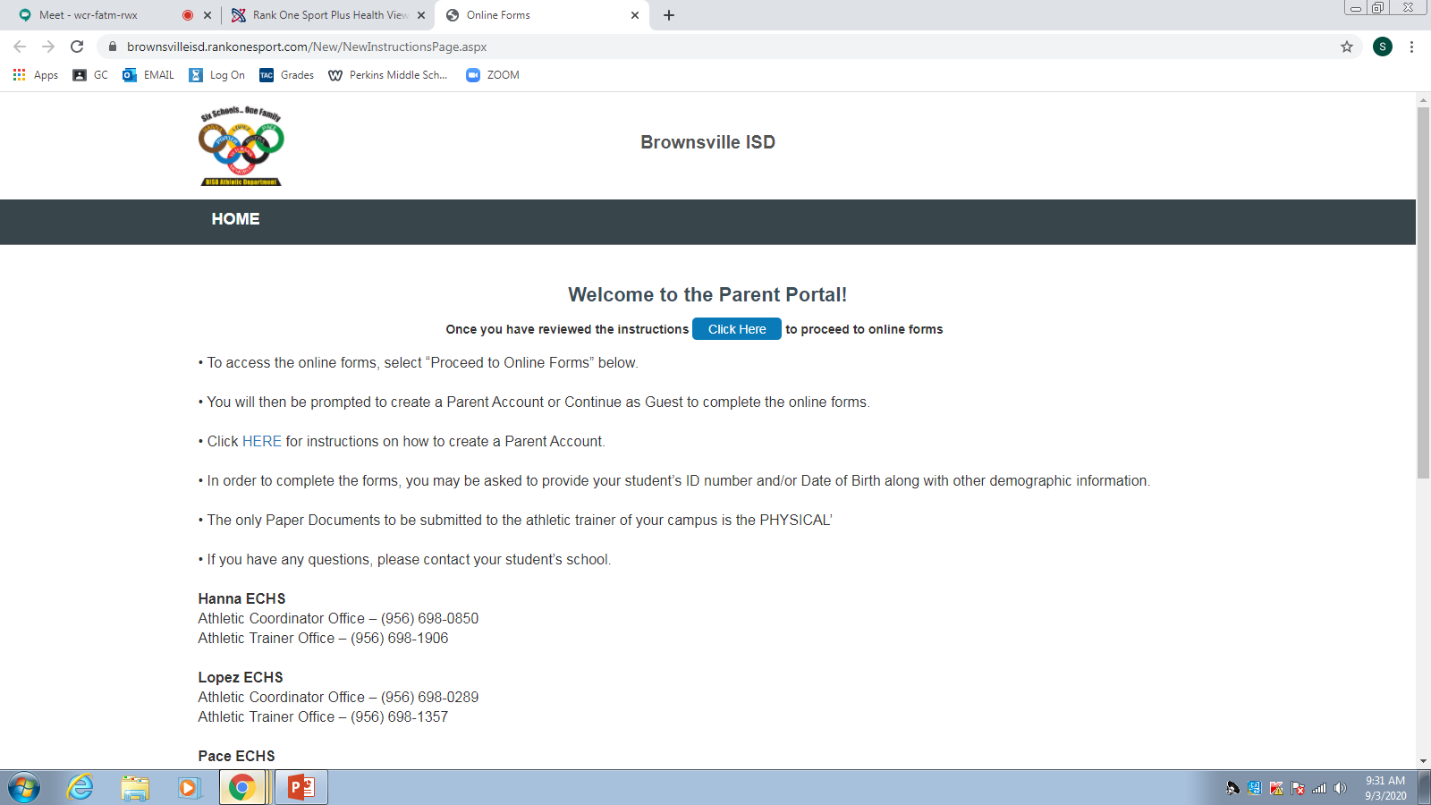
5th Step
Click – On Online Forms
Click Here

Slide 8
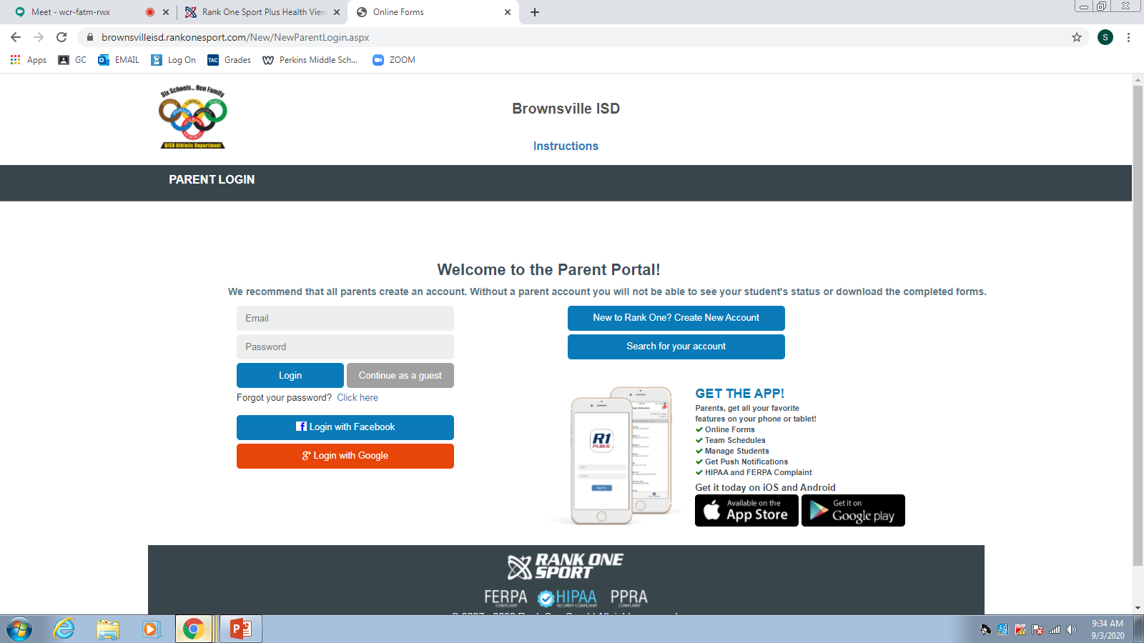
6th Step
Click – On Online Forms
Click HERE

Slide 9
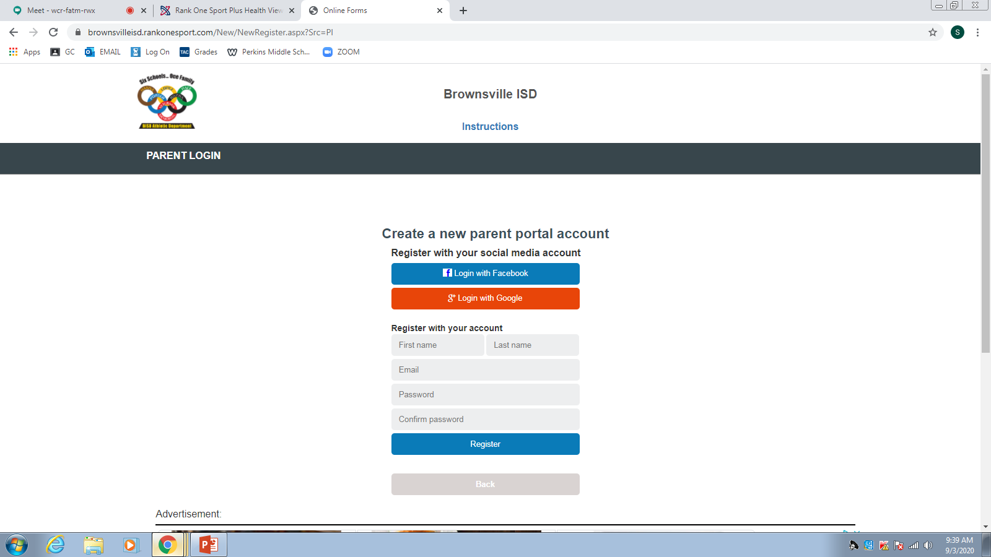
7th Step
Click – On Online Forms
Fill out the Information

Slide 10
8th Step
Click – On Online Forms
Click Here
Fill out the Information

Slide 11
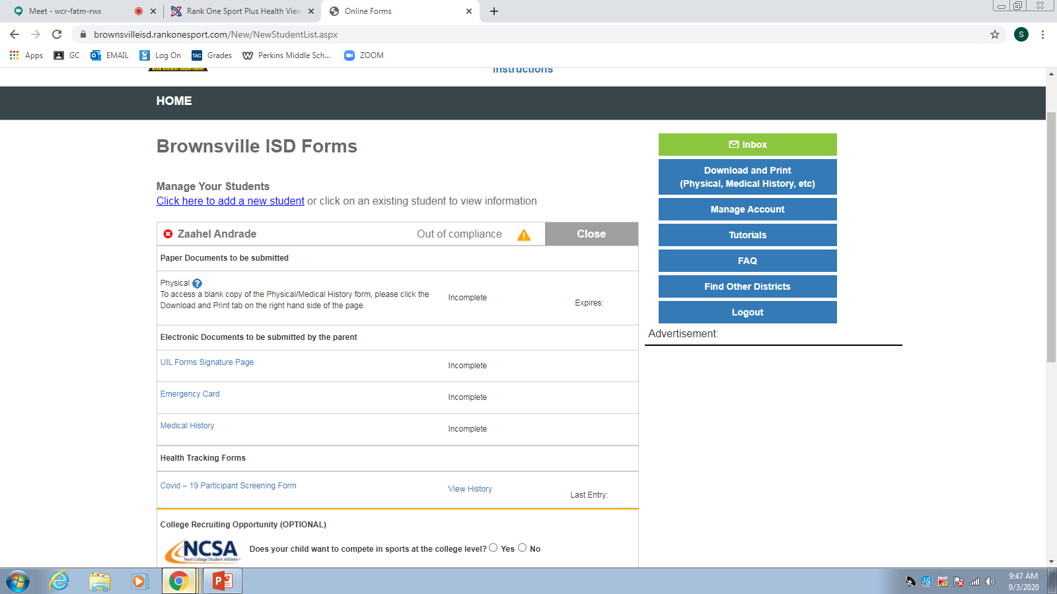
9th Step
Print Physical
Click – On Online Forms
Fill Out 1
If you can not Print our the Physical- When you make an appointment with your Doctor, make sure you request the Sports Physical Form as well.
Fill Out 2
Fill Out 3

